Slide 1
Lecture 8:
Justice and Rights
Course: Environment and Politics in India

Slide 2
Equality
The concept of equality:
Relationship between 2 or more persons/groups.
Evolving concept (Aristotle, Hobbes, Rousseau, Marx). Various aspects of equality.
EQUALITY as UNIFORMITY?
  Commitment to ‘UNIFORMITY’ of “ends”? (EXAMPLES: Equal home size, equal income, equal grades)
  Uniformity of access/equal treatment? (EXAMPLE: law)
  Problems in the above arguments. So why equalise?
  Commitment to fairness (EXAMPLE: Contract workers’ demand for poore kaam ka poora daam).
  Necessary for self-respect. Correlation between self-image and society’s perception (EXAMPLE: Dalit experience).
  Necessary for fraternal relations and respect

Slide 3
Equality
Equality of WHAT?
Equality of WELFARE:
  Related to Desire OR preference-satisfaction.
  Does NOT depend on HOW MUCH, depends on WHAT can be done with resources.
  NOT related to fairness/self-respect/fraternity.
  LIMITATIONS: Car/jewellery versus bicycle/lantern.
  Equality of RESOURCES:
    Distribution of resources.
    CENTRALITY of the STATE. EXAMPLES: Taxing the rich more than the poor. Needs to think about “endowments” and “ambitions”.
    Equality of CAPABILITIES:
      Emphasis on OPPORTUNITY rather than on INCOME/RESOURCES.
      Reading, writing, self-dignity, political participation.

Slide 4
Justice
Is Justice ONLY about the LAW?
Unjust laws (EXAMPLES: Apartheid, Segregation)
Many changing notions:
  Plato: Remaining ‘true’ to one’s ‘nature’ (VIRTUE), fulfilling duties diligently
  Aristotle: Equality, Proportionality, Reciprocity, Maintenance of equilibrium. Shift from Plato’s notion of hierarchy
  NOW: No longer a ‘religious’ concept or based on TRADITIONAL practices.
  Set of PRINCIPLES to be upheld by the STATE to make life more regulated.
The issue of DISTRIBUTIVE Justice:
  WHO deserves WHAT? EXAMPLES: Workers versus Cricketers, Student Grades
  Who NEEDS what? Privileging NEEDS over CAPABILITIES.

Slide 5
Justice
  Procedural Justice:
    When RULES are followed.
    OUTCOMES/ ‘Just’ DISTRIBUTION is not relevant.
    Justice is about individual behavior, not about structures in society.
    Lesser involvement of the State. Defence of individual liberty.
    EXAMPLES: Races, Property acquisitions
  Social Justice:
    Justice is a feature of SOCIETY.
    Evaluation done on basis of whether society itself is FAIR.

Slide 6
Justice
  John Rawls’ theory: Justice as FAIRNESS
  Despite meticulous following of rules, unjust conditions follow.
  Rawls’ PRINCIPLES of justice:
  Each person is to have an equal right to the most extensive liberty compatible with similar liberty to others.
  Social and economic inequalities are to be arranged so that they are both:
a) to the greatest benefit of the least advantaged, and
b) attached to offices and positions open to all under conditions of fair equality and opportunity.
    NO RISK of individual liberty being compromised by liberty of others. Defence of inequality, class/caste divisions.
    Justifying the ‘inevitable’ divisions, power structures in society.
    2. ‘Inequality’ in treatment should HELP the MARGINALISED.
    Ambedkar and the Indian Constitution: Justice and Equality.

Slide 7
Justice
  FEMINIST critique of Rawls and theories of justice:
  Family/housework is considered ‘PRIVATE’. Not part of the ‘public’ concept of justice. Overlooks:
    Family is ITSELF governed by the ‘public’. Inheritance/divorce laws.
    Social reproduction of labour.
    Any theory that overlooks unequal relations in the family is INCOMPLETE.
    END-STATE/SOCIAL JUSTICE theories:
    Each person receives in accordance to labour contribution in production. Differences in skill/talent? Differences in NEEDS?
    MARX: “From each according to his capacity, to each according to his need”. No NEED for ‘justice’ in a truly ‘good’ community, with no NEEDS/conflict/scarcity.

Slide 8
Rights
    VERY foundation of many modern political organizations. US Declaration of Independence (1776), French Declaration of the Rights of Man and of the Citizen, Civil Rights movement, Human Rights, Women’s Rights, LGBTQI rights…
    RIGHT is one’s DUE, entitlement to DO something or have something DONE (to vote, to avail of healthcare)
    SOCIAL character of Rights: RIGHTS are CLAIMS that are justified on LEGAL, MORAL, ETHICAL or HUMAN grounds.
    NEGATIVE and POSITIVE rights:
      Negative rights: Non-interference from society/State (Right to property/life). No need to DO anything.
      Positive rights: Active provision of something (Healthcare/education/basic subsistence)

Slide 9
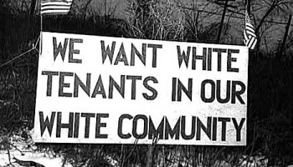
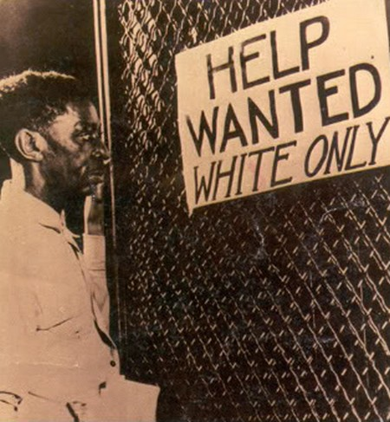
Rights
      CIVIL rights:
        Status of equal citizenship in a liberal democratic State.
        THEN: Right to own property/legal recourse/practice religion/speech.
        NOW: Personal, Political and economic rights.
      POLITICAL rights:
        Right to stand for public office/vote/testify in court.
        ECONOMIC rights:
        Right to food/shelter/medical care/employment.
        CULTURAL MEMBERSHIP rights:
        Rights of indigenous people
        Political autonomy?

Slide 10
Rights
        THEORIES of Rights:
        The Theory of Natural Rights: Right to remain in the ‘state of nature’, to act according to the ‘law of nature’. Absence of government/ORGANISED political authority.
        The UTILITARIAN theory of rights: Acting according to the theory that the ‘’community’ must achieve MAXIMUM’ utility.
        Very popular with policy-makers (Nehru and the Hirakud Dam)
        Assumes that UTILITY can be QUANTIFIED. By WHOM?
        Justifies the impoverishment of SOME members.
        John RAWLS on rights.
        LIBERTARIAN theory of rights: Emphasizes procedural justice, puts individuals rights (over property etc.) ABOVE ALL.

Slide 11
Rights
        HUMAN RIGHTS:
        WHAT are they? International MORAL and LEGAL norms. Applicable to the STATE.
        SECURITY rights: Against murder/rape/torture
        LIBERTY rights: Freedom of belief/expression/association
        POLITICAL rights: Right to participate in political activity/vote/serve in public office
        DUE PROCESS rights: Against illegal detention/punishment without trial
        EQUALITY rights: Equality under law, protection against discrimination
        WELFARE rights: Economic and Social rights (food/education/health etc.)
        GROUP rights: Protection against genocide, religious/ethnic discrimination.

Slide 12
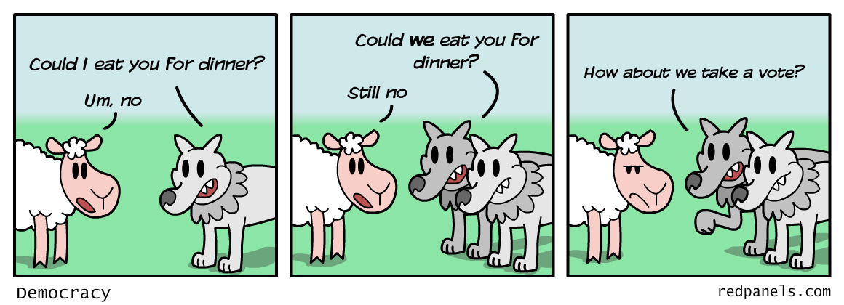
Rights
      MULTICULTURAL perspective on human rights:
  Differences in society need to be accommodated.
  Some groups are less advantaged in the CULTURAL/political sphere.
  GROUP-DIFFERENTIATED rights to preserve cultures: territorial autonomy, veto powers, guaranteed representation, land claims, language rights.
  LIMITATIONS: Assaults on democratic values.

